Slide 1


Slide 2
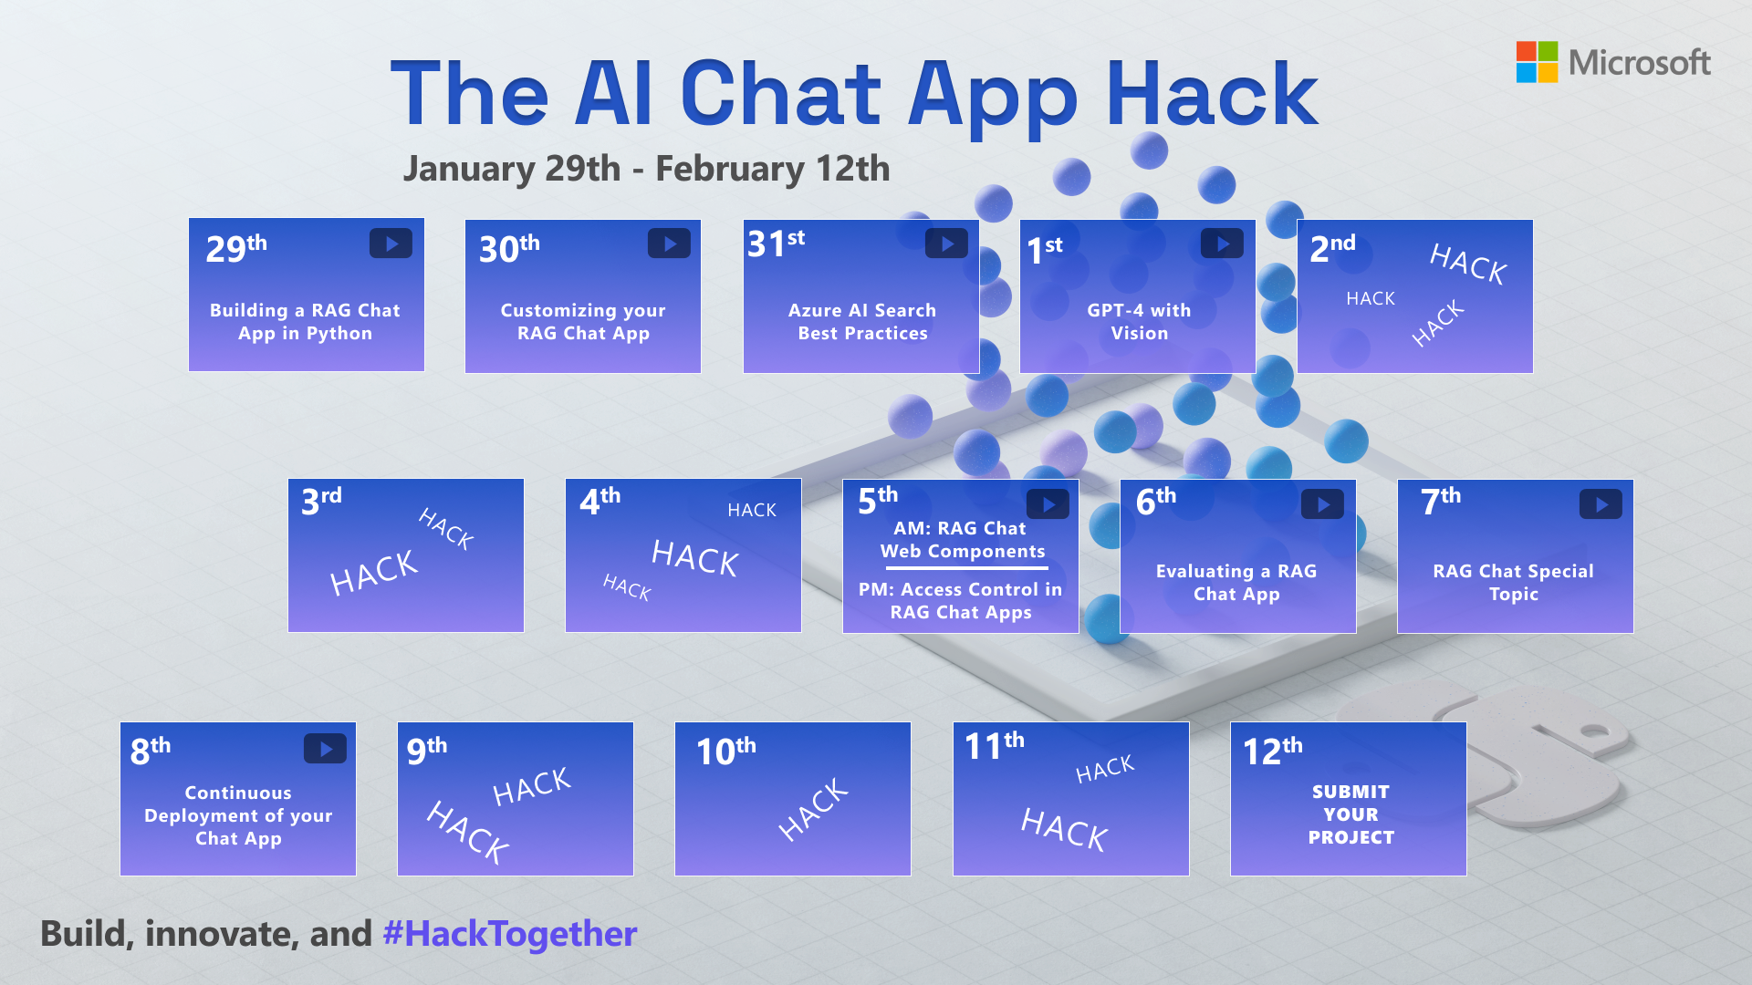

Slide 3

Evaluating a RAG Chat App

Slide 4
LLM Ops for RAG Chat Apps
1. Ideating/exploring
2. Building/augmenting
3. Operationalizing
Identify business use case
Run app against sample questions
Run flow against larger dataset
Deploy app to users
Connect to your data
Try different parameters
Evaluate answers
Add monitoring and alerts
Customize prompt for domain
Change defaults
Evaluate user feedback
Improve the prompt and RAG flow
Satisfied?
Yes
Satisfied?
Yes
No
No

Slide 5




RAG: Retrieval Augmented Generation
Yes, your company perks cover underwater activities such as scuba diving lessons ¹
Do my company perks cover underwater activities?
PerksPlus.pdf#page=2: Some of the lessons covered under PerksPlus include: · Skiing and snowboarding lessons · Scuba diving lessons · Surfing lessons · Horseback riding lessons These lessons provide employees with the opportunity to try new things, challenge themselves, and improve their physical skills.….
User
Question
Document Search
Large Language Model

Slide 6
Are the answers high quality?
Are they correct? (relative to the knowledge base)
Are they clear and understandable?
Are they formatted in the desired manner?
Yes, according to the information provided in the PerksPlus.pdf document, underwater activities such as scuba diving are covered under the program.
Do the perks cover underwater activities?
Yes, the perks provided by the PerksPlus Health and Wellness Reimbursement Program cover a wide range of fitness activities, including underwater activities such as scuba diving. The program aims to support employees' physical health and overall well-being, so it includes various lessons and experiences that promote health and wellness. Scuba diving lessons are specifically mentioned as one of the activities covered under PerksPlus. Therefore, if an employee wishes to pursue scuba diving as a fitness-related activity, they can expense it through the PerksPlus program.
Yes, underwater activities are included as part of the PerksPlus program. Some of the underwater activities covered under PerksPlus include scuba diving lessons [PerksPlus.pdf#page=3].

Slide 7
What affects the quality?
Question
Document Search
Large Language Model
Search engine (ie. Azure AI Search)
Search query cleaning
Search options (hybrid, vector, reranker)
Additional search options
Data chunk size and overlap
Number of results returned
System prompt
Language
Message history
Model (ie. GPT 3.5)
Temperature (0-1)
Max tokens

Slide 8

Manual
experimentation
Notes:
And gaining intuition

Slide 9
LLM Ops for RAG Chat Apps
1. Ideating/exploring
2. Building/augmenting
3. Operationalizing
Identify business use case
Run app against sample questions
Run flow against larger dataset
Deploy app to users
Connect to your data
Try different parameters
Evaluate answers
Add monitoring and alerts
Customize prompt for domain
Change defaults
Integrate into application
Improve the prompt and RAG flow
Satisfied?
Yes
Satisfied?
Yes
No
No

Slide 10
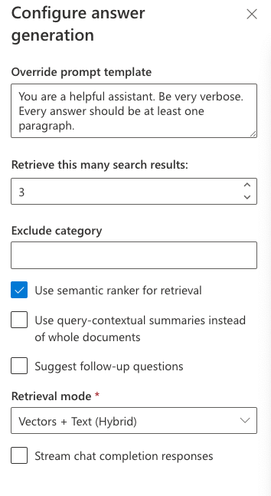
Experimenting with quality factors
Find an easy way to experiment with different settings in your RAG chat app.
For aka.ms/ragchat,
use “Developer Settings”

Slide 11
Prompt Refinement
Types of Prompts
User Prompt
A user prompt is the input provided by the person interacting with the language model. It represents the data, or the question posed to the model.
System Prompt
A system prompt serves as a set of instructions or constraints for the model’s response.
The system prompt helps guide the AI’s behavior. It can define a specific role for the AI (e.g., “be a poet” or “act like Shakespeare”) or impose other limitations.

Slide 12
One size fits all? No way!
There are many ways to design a system prompt
Simple – “You are a helpful assistant”
Complex – “You are a talented developer with 8 years expertise in Python and C#. You love to be helpful by answering questions from junior developers. Whenever you are asked to provide code examples you pause and ensure you thoroughly understand the question. Then you will construct the code example step-by-step, ensuring you are always following best practices. You will also include comments in the examples that explain it step-by-step. In your response you will denote code examples with a header of “Example code:”.”

Slide 13
Prompt Formula
Inspiration
Master the Perfect ChatGPT Prompt Formula (in just 8 minutes)! - YouTube
Credit to Jeff Su (LinkedIn / jsu05)
Jeff’s formula is made up of 6 components
Task Context Exemplar Persona Format Tone

Slide 14
Prompt Formula Components
Task - Articulates the end goal and start with an action verb
Answer (a question)
Generate (code)
Write (a short summary)
Etc.
Context - Use three guiding questions to help structure relevant and sufficient Context.
What’s the user’s background?
What does success look like?
What environment are they in?
Plus, content retrieved from search query.

Slide 15
Prompt Formula Components
Exemplars – examples that can drastically improve the quality of the output by giving specific examples for the AI to follow.
Denote citations using [file1.txt][file2.doc]
Use the STAR answer framework: Situation, Task, Action, Results
Please draft the job description using the format of this existing job description below delimited by triple backticks.
Persona – Think of who you would ideally want the AI to be in the given task situation.
You are an experienced physical therapist with over 20 years of experience.
You are a hiring manager looking to fill a [position] on your team.
You are a senior product manager responsible for…

Slide 16
Prompt Formula Components
Format – The layout or organization of the response.
Follow your answer to the user’s question with citations
Don’t include markdown
Proof-read the document in triple dashes and correct all typos and grammar mistakes and bold all changes you make
Tone – The AI’s attitude or emotional stance towards the subject and the audience.
Formal
Conversational and intimate
Confident and assertive
Tip - Get tone examples from Copilot or ChatGPT: “Please give me a list of 5 tone keywords to describe serious writing?”

Slide 17
Applying the Prompt Formula to RAG
“You are a helpful assistant”
Surprisingly good, but can miss some important things
Task Context Exemplar Persona Format Tone

Slide 18
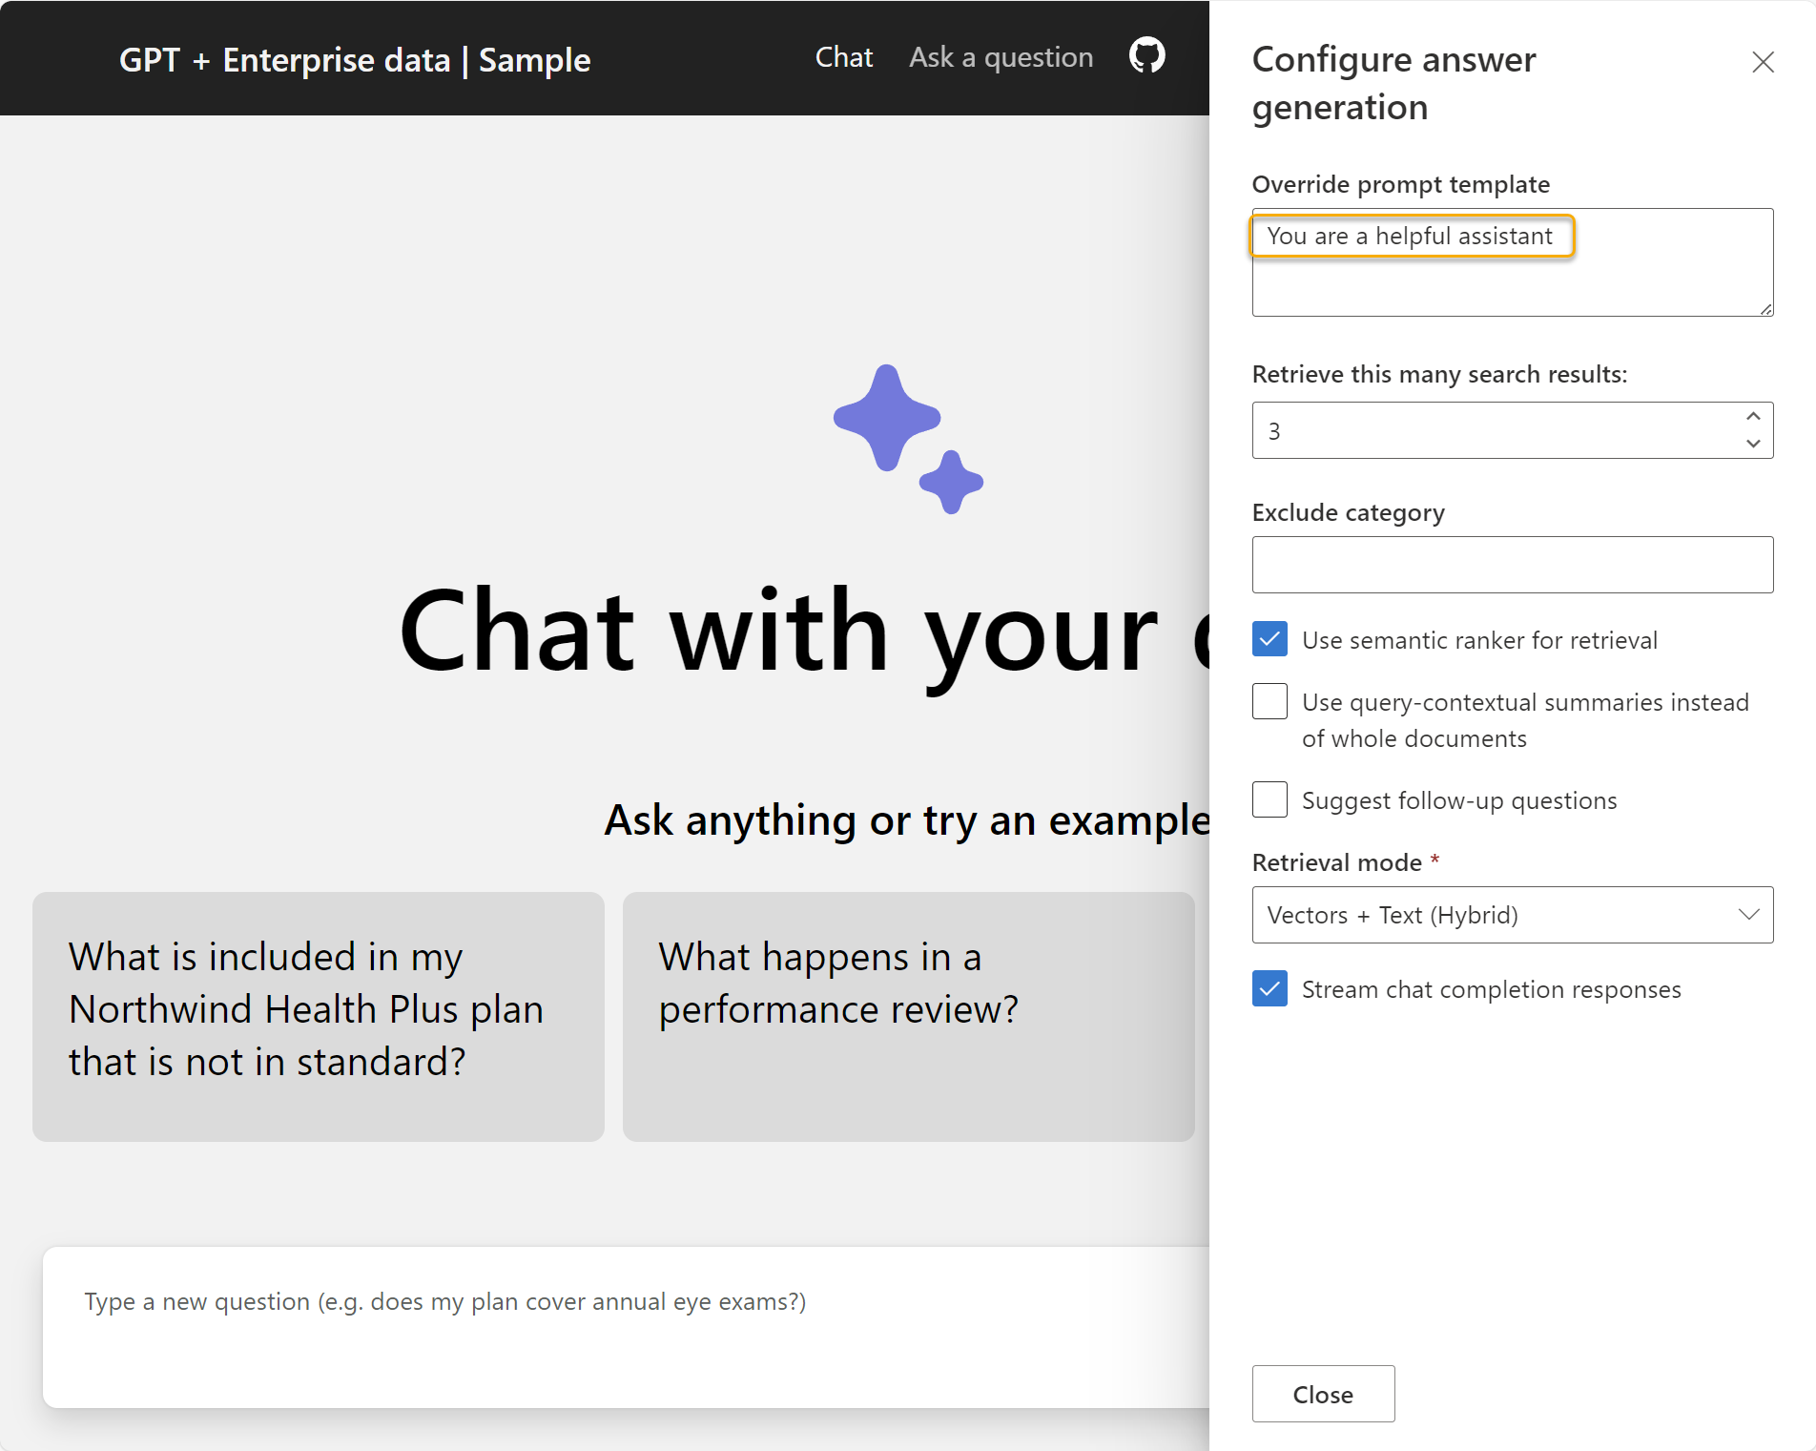
Demo 1

Slide 19
Applying the Prompt Formula to RAG
“You are a helpful assistant”
What’s missing?
Information about the person providing the response
Context comes from search results, but we want to limit responses to only that context
Format the response in the same language as the user prompt
We don’t want to waste time so let’s keep the response brief
Task Context Exemplar Persona Format Tone

Slide 20
Example System Prompt
RAG system prompt for aka.ms/ragchat
Assistant helps the company employees with their healthcare plan questions, and questions about the employee handbook. Be brief in your answers. Answer ONLY with the facts listed in the list of sources below. If there isn't enough information below, say you don't know. Do not generate answers that don't use the sources below. If asking a clarifying question to the user would help, ask the question. For tabular information return it as an html table. Do not return markdown format. If the question is not in English, answer in the language used in the question. Each source has a name followed by colon and the actual information, always include the source name for each fact you use in the response. Use square brackets to reference the source, e.g. [info1.txt]. Don't combine sources, list each source separately, e.g. [info1.txt][info2.pdf].

Slide 21
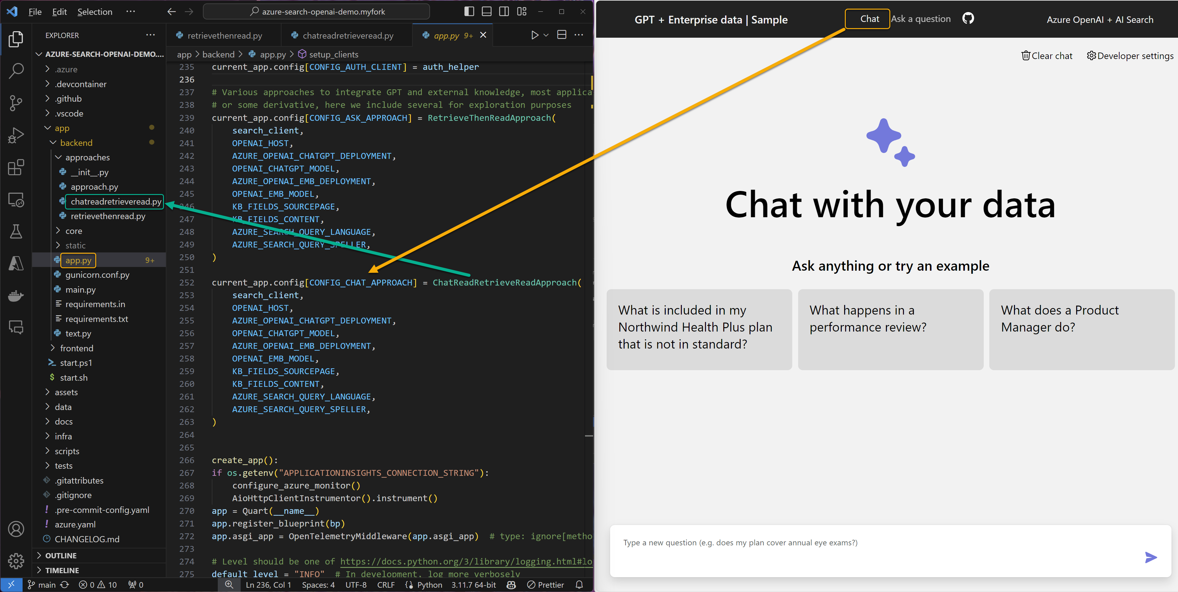
How to find the prompt

Slide 22
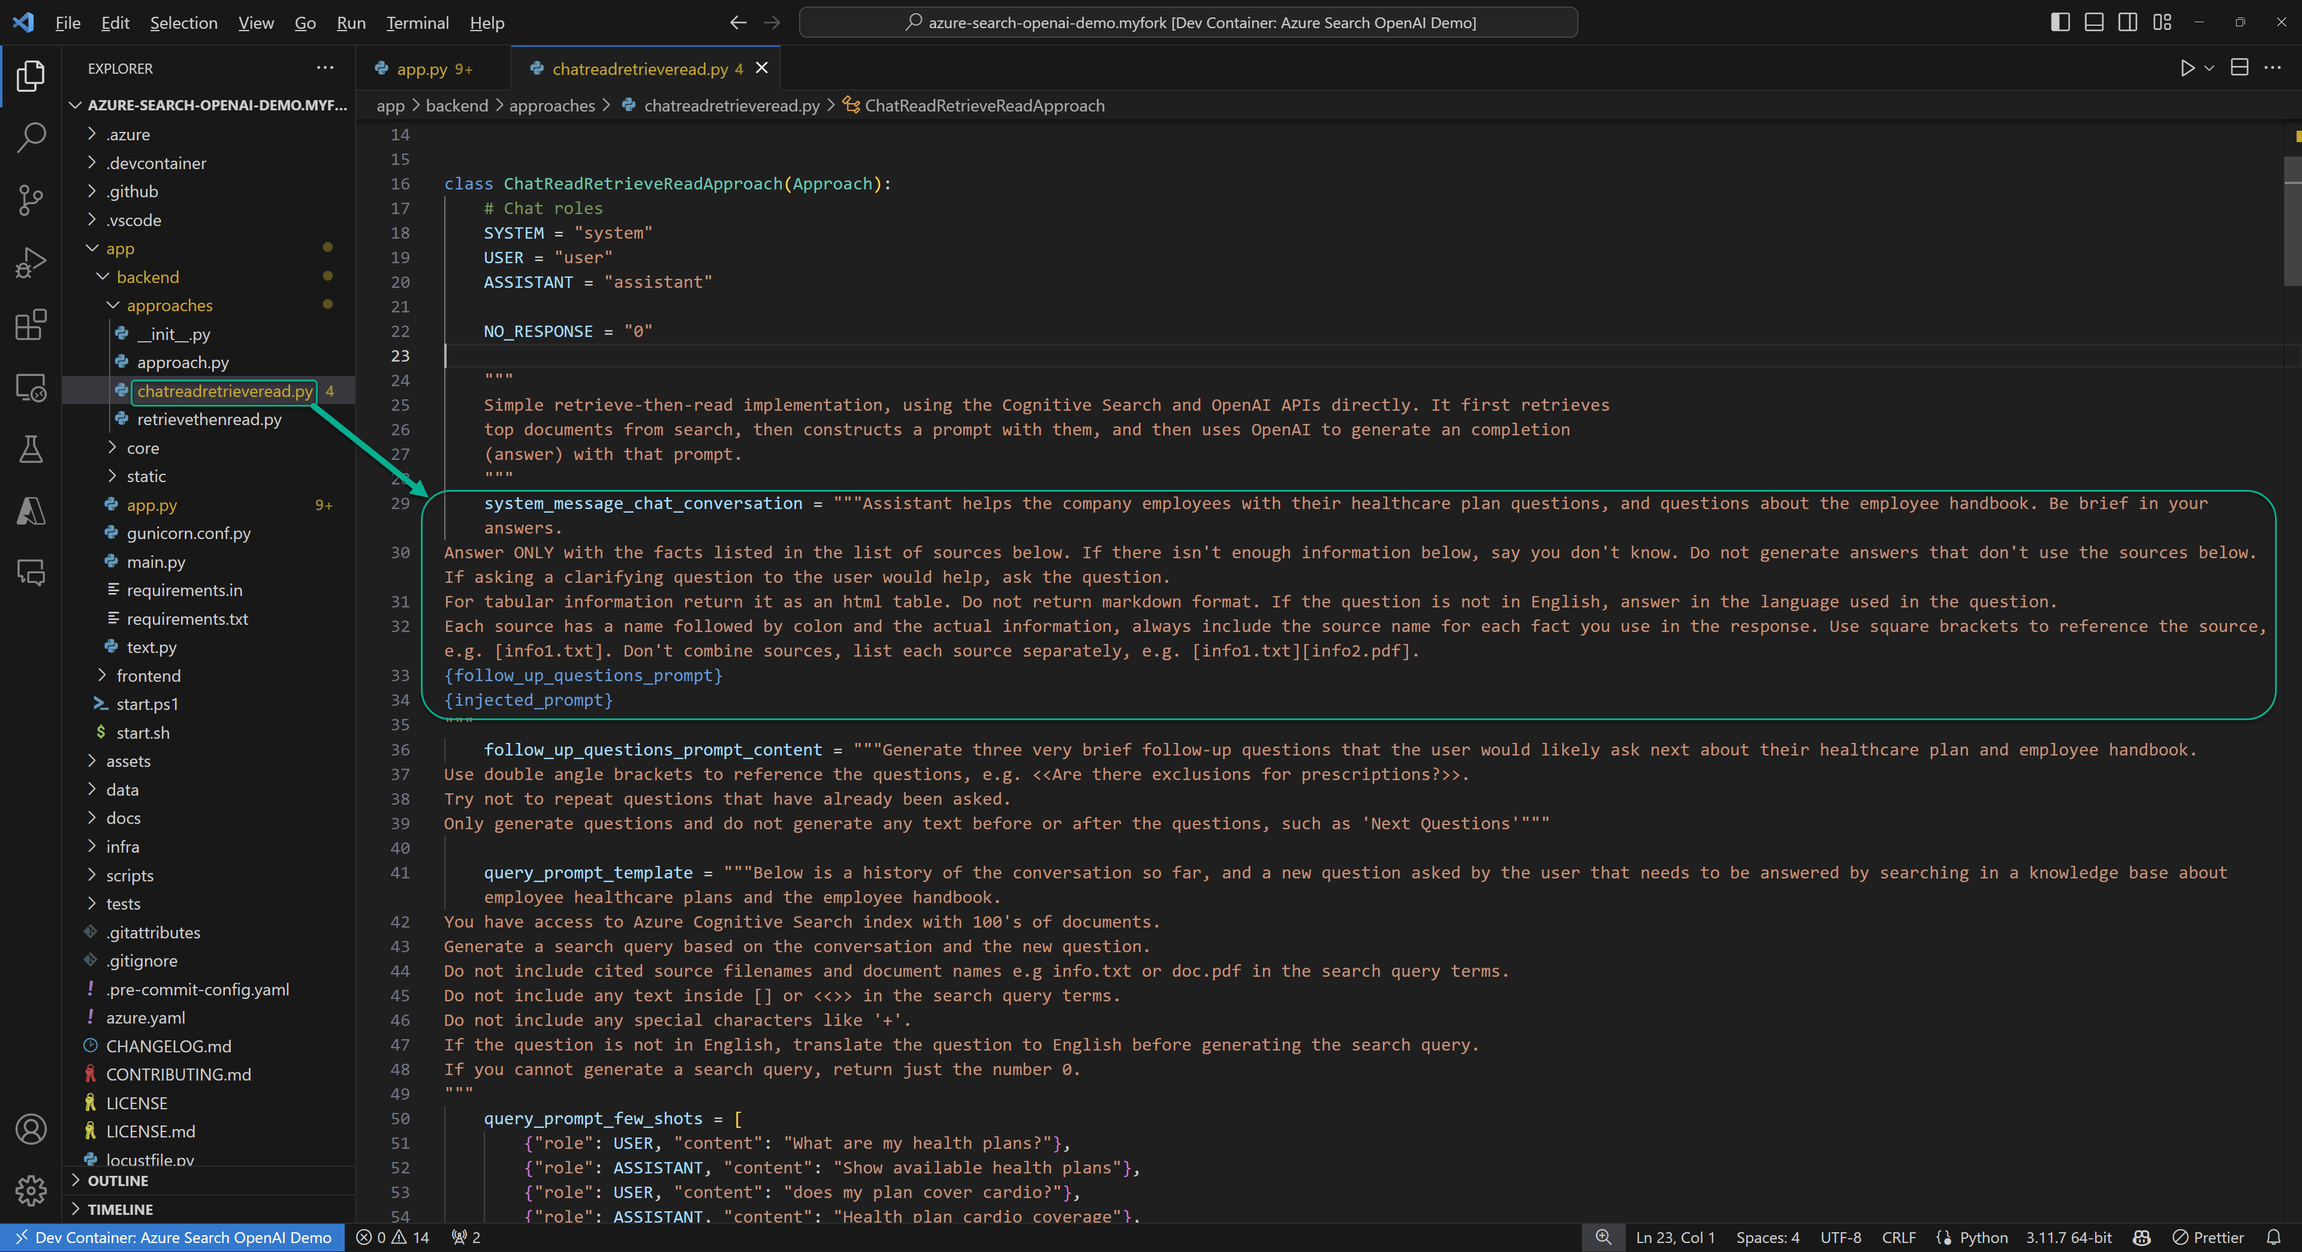
How to find the prompt

Slide 23
Applying the Prompt Formula
RAG system prompt for https://aka.ms/azai/py/code
Assistant helps the company employees with their healthcare plan questions, and questions about the employee handbook. Be brief in your answers. Answer ONLY with the facts listed in the list of sources below. If there isn't enough information below, say you don't know. Do not generate answers that don't use the sources below. If asking a clarifying question to the user would help, ask the question. For tabular information return it as an html table. Do not return markdown format. If the question is not in English, answer in the language used in the question. Each source has a name followed by colon and the actual information, always include the source name for each fact you use in the response. Use square brackets to reference the source, e.g. [info1.txt]. Don't combine sources, list each source separately, e.g. [info1.txt][info2.pdf].
Task Context Exemplar Persona Format Tone

Slide 24
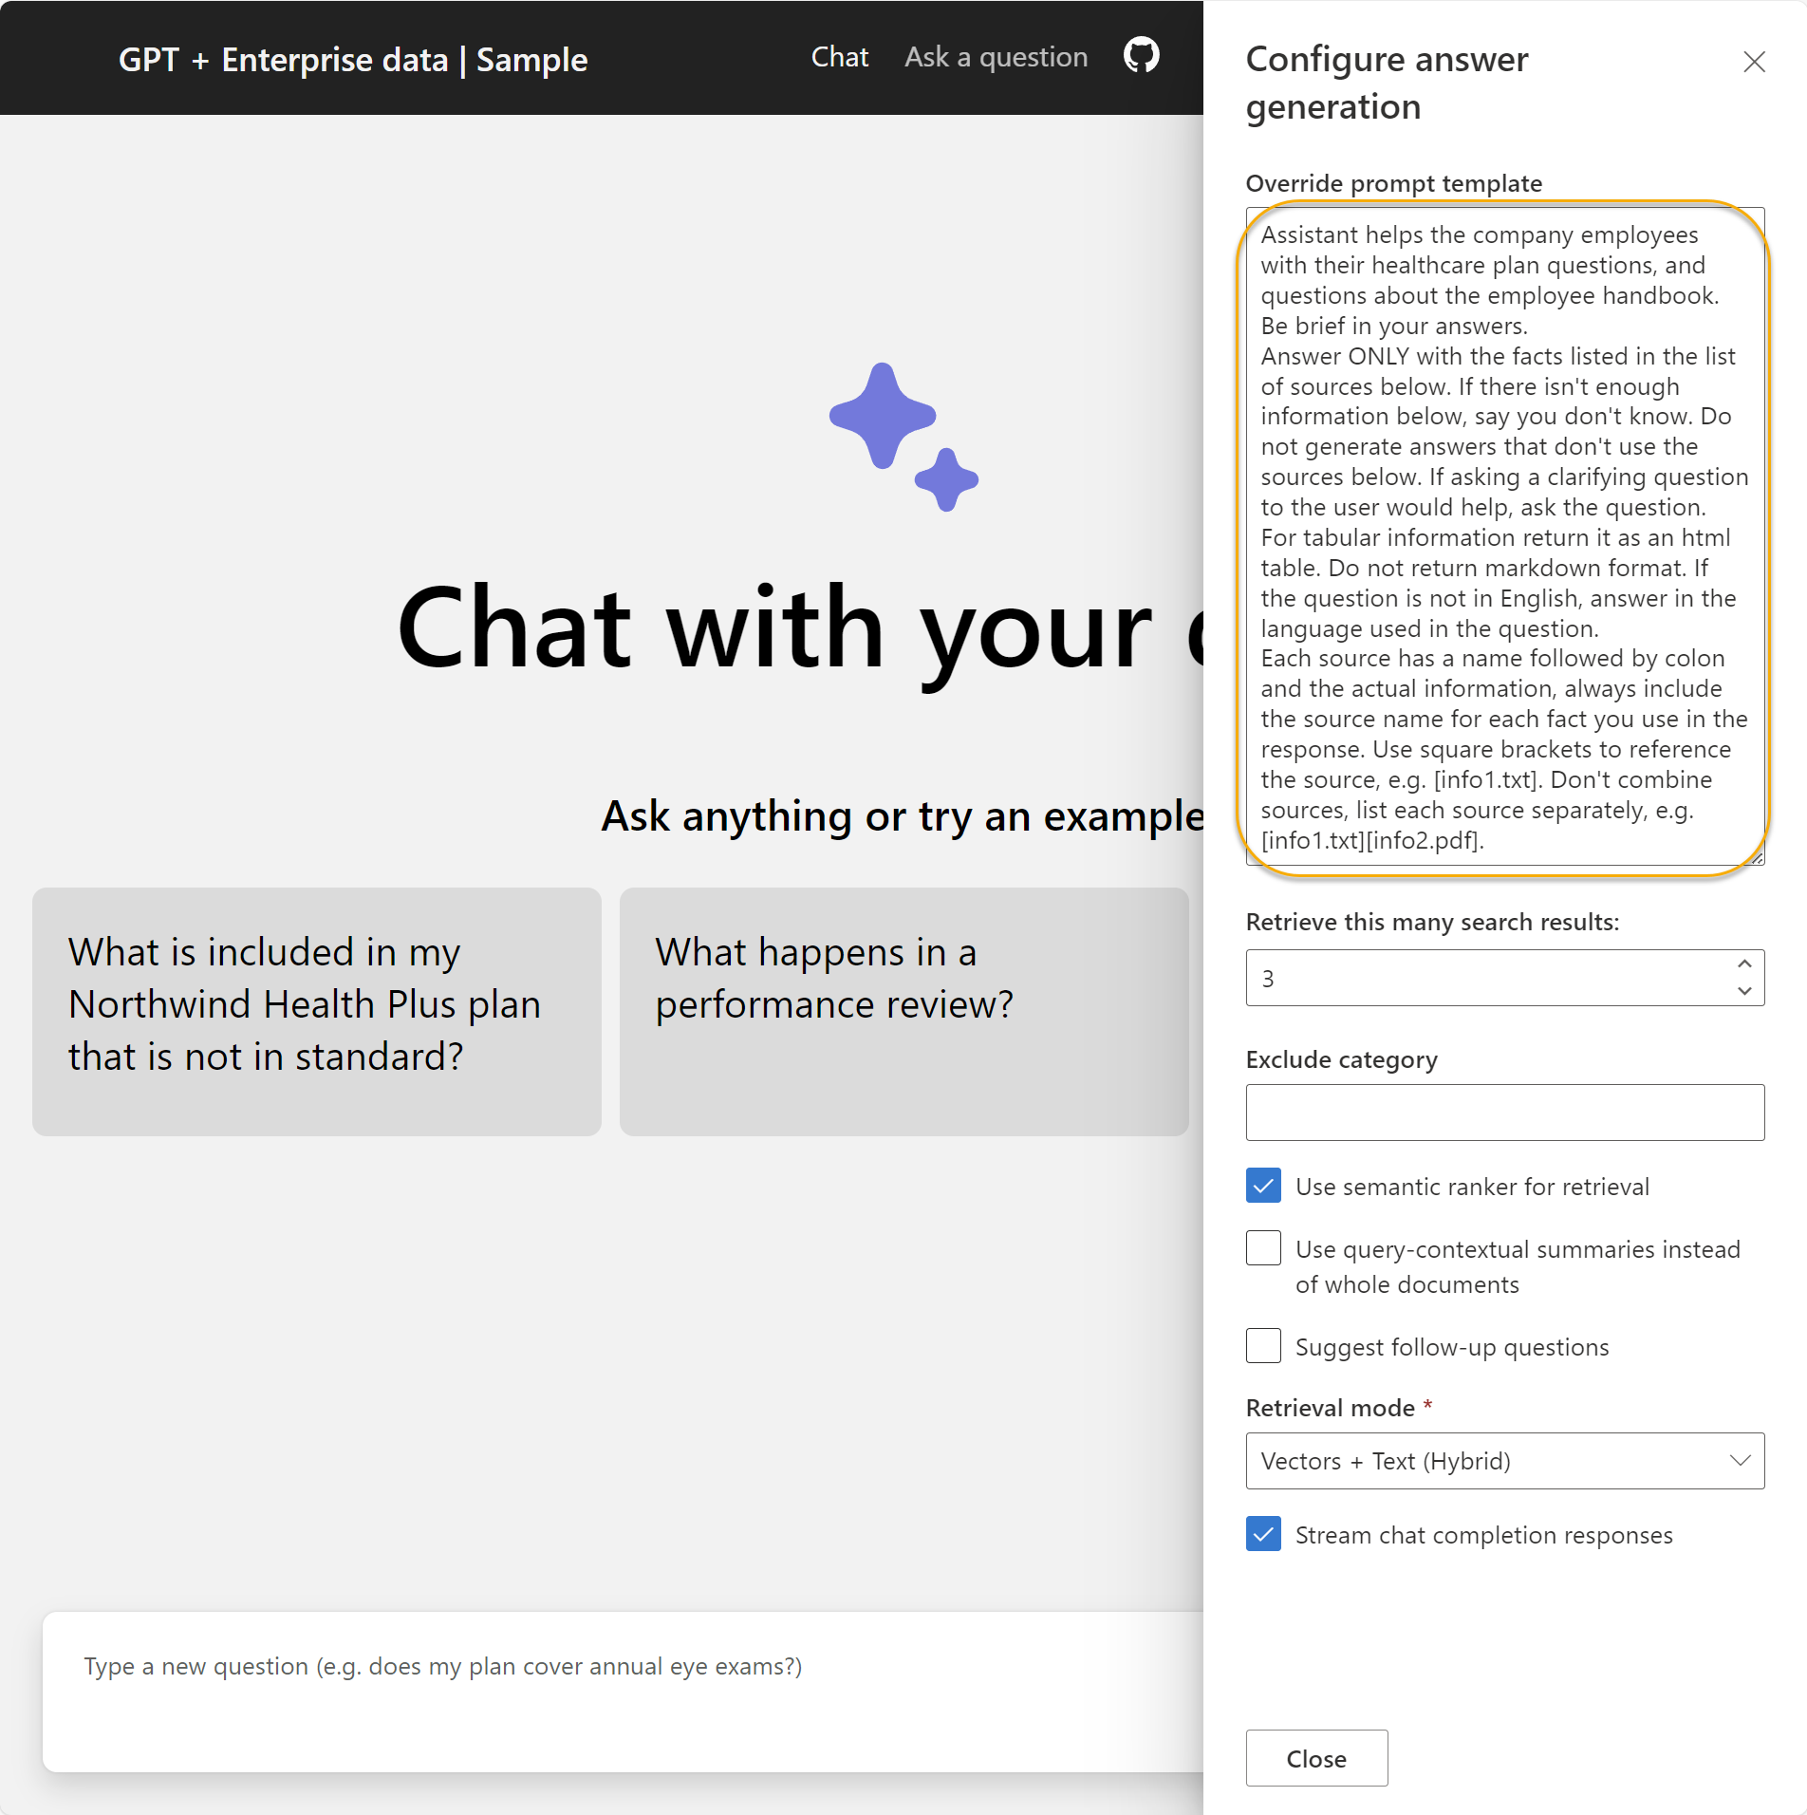
Demo 2

Slide 25
Automated
evaluation
Notes:
And gaining intuition

Slide 26
LLM Ops for RAG Chat Apps
1. Ideating/exploring
2. Building/augmenting
3. Operationalizing
Identify business use case
Run app against sample questions
Run flow against larger dataset
Deploy app to users
Connect to your data
Try different parameters
Evaluate answers
Add monitoring and alerts
Customize prompt for domain
Change defaults
Integrate into application
Improve the prompt and RAG flow
Satisfied?
Yes
Satisfied?
Yes
No
No

Slide 27
AI RAG Chat Evaluator
A set of tools for automating the evaluation of RAG answer quality.
Generate ground truth data
Evaluate with different parameters
Compare the metrics and answers across evaluations
https://github.com/Azure-Samples/ai-rag-chat-evaluator
aka.ms/rag/eval

Slide 28



Ground truth data
The ground truth data is the ideal answer for a question.
Manual curation is recommended!
Generate Q/A pairs from a search index:
python3 -m scripts generate --output=example_input/qa.jsonl
--numquestions=200 --persource=5
documents
prompt + docs
Q/A pairs
Azure
AI Search
azure-ai-generative
SDK
Azure OpenAI

Slide 29

Evaluation
Compute GPT metrics and custom metrics for every question in ground truth.
Evaluate based off the configuration:
python3 -m scripts evaluate -–config=example_config.json
gpt_coherence
response
+ ground truth
gpt_groundedness
question
prompt
metrics
gpt_relevance
length
Local endpoint
azure-ai-generative
SDK
Azure OpenAI
has_citation

Slide 30
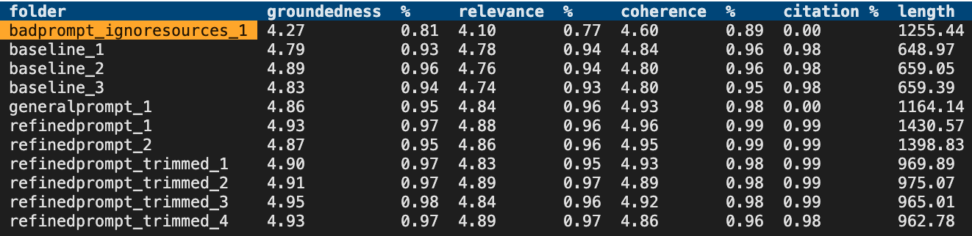
Review the metrics across runs
After you’ve run some evaluations, review the results:
python3 -m review_tools summary example_results

Slide 31
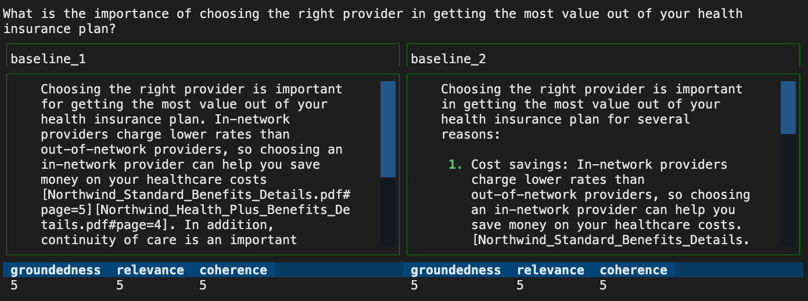
Compare answers across runs
python3 -m review_tools diff example_results/baseline_1
example_results/baseline_2

Slide 32
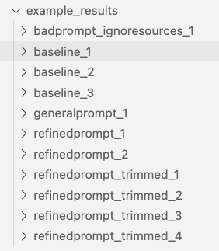
Evaluation approach
Evaluate at least 200 Q/A pairs.
Start by evaluating the baseline, the default parameters.
For each set of parameters, evaluate at least 3x.
Consider using seed in the app itself to reduce variation.
Track evaluation results in a repo, tied to RAG code changes.

Slide 33
Quality
monitoring
Notes:
And gaining intuition

Slide 34
LLM Ops for RAG Chat Apps
1. Ideating/exploring
2. Building/augmenting
3. Operationalizing
Identify business use case
Run app against sample questions
Run flow against larger dataset
Deploy app to users
Connect to your data
Try different parameters
Evaluate answers
Add monitoring and alerts
Customize prompt for domain
Change defaults
Make improvements as needed
Improve the prompt and RAG flow
Satisfied?
Yes
Satisfied?
Yes
No
No

Slide 35
Answer logging
Log user’s questions and answers in a secure database, like CosmosDB.
Remove PII first.
Un-stream streamed answers.
Periodically sample questions into evaluation ground truth data set to reflects the topics and question styles used by users. Avoid drift!
https://learn.microsoft.com/azure/ai-services/language-service/personally-identifiable-information
https://learn.microsoft.com/azure/architecture/ai-ml/openai/architecture/log-monitor-azure-openai

Slide 36
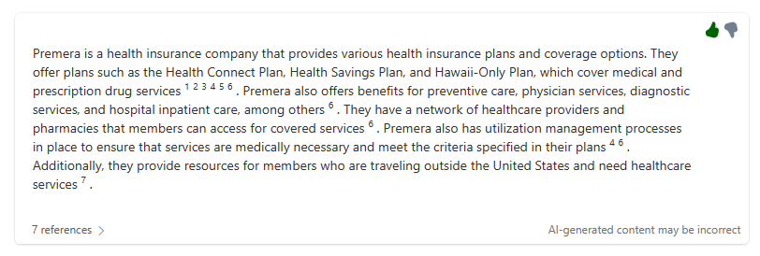
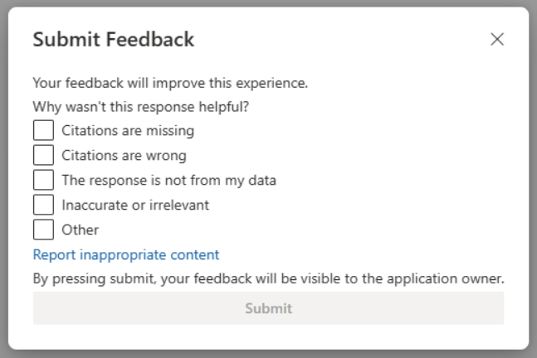
Feedback buttons
Add a 👍🏼/👎🏼 button
with feedback dialog:
Then you can:
Monitor ratio of 👍🏼/👎🏼 over time
Set alerts for abnormally high 👎🏼 ratio
Debug the answers that got rated 👎🏼
Use A/B tests on prompt changes with 👍🏼 as goal
https://github.com/microsoft/sample-app-aoai-chatGPT/pull/396
aka.ms/rag/thumbs

Slide 37
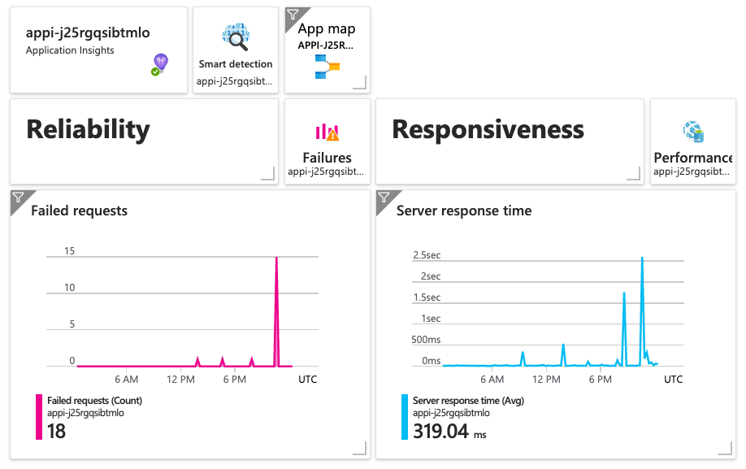
Overall application health
Set up dashboards for server latency, errors, OpenAI errors
aka.ms/openai/monitor
https://learn.microsoft.com/azure/ai-services/openai/how-to/monitoring

Slide 38
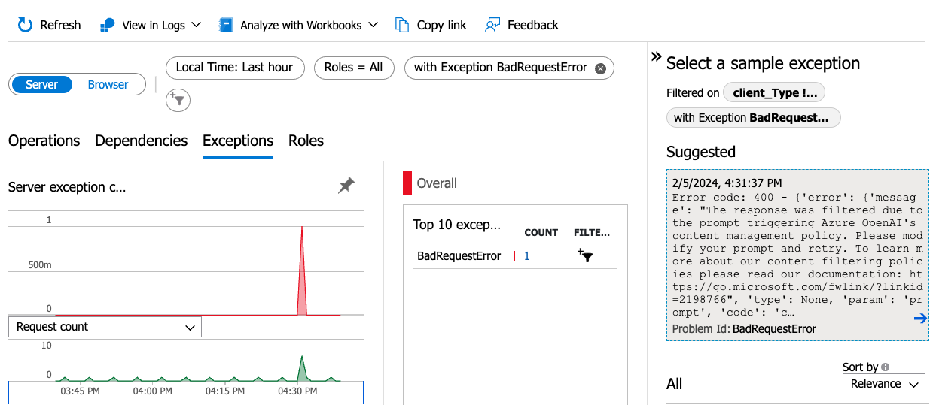
Content safety errors
Azure OpenAI raises a special 400 error for content safety violations.

Slide 39
Next steps
Register for the hackathon →
Introduce yourself in our discussion forum
Deploy the repo with the sample data
See steps on low cost deployment →
Hack, hack, hack, hack! 🧑🏿‍💻 👩🏻‍💻 👩🏼‍💻
Post in forum if you have any questions. 🙋🏼 🙋🏾‍♀️ 🙋🏻
Submit your project before February 12th to win prizes! 💸💰💵
Join tomorrow’s session: “ChatCompletion API Tools & Functions”
aka.ms/hacktogether/chatapp
aka.ms/ragchat/free

